Slide 1

Banking Data Analysis With
By Piyush Kadam

Slide 3

1.Introduction :
Welcome to my presentation on bank analysis using SQL. This project aims to provide comprehensive insights into banking data through the effective use of SQL for data extraction, transformation, and analysis. By leveraging SQL's robust querying capabilities, we delve into various aspects of banking operations, from transaction patterns and customer behaviors to financial performance metrics.

Slide 4
2. Overview-
01
Table Consisting Information related to bank accounts of customers with the primary key as cusomer_id.
This table consist the remaining balance of each customer.
Accounts Table :-
02
Table consist the each branch information here branch_id is the primary key.
Branches :-
03
Gathering all the useful data about customers with custoemer_id as a unique id.
Key highlight of this table is it contain the date of account created
Customers :-
04
This is nothing but the giant of out project giving us valuable information related customers transaction.
The primary key of this table is transaction_id and account_number.
Transactions :-

Slide 5

3. Drive Through Each Query

Slide 6
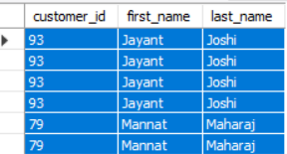
Q.1
SELECT C.customer_id,c.first_name,c.last_name
from customers c join accounts a on c.customer_id=a.customer_id left join transactions t on a.account_number=t.account_number
where t.transaction_id is null
or
t.transaction_date<date_sub(curdate(),interval 1 year);
Write a query to list all customers who haven't made any transactions in the last year. How can we make them active again?
984 Customers havent made transaction in last year from now.

Slide 7
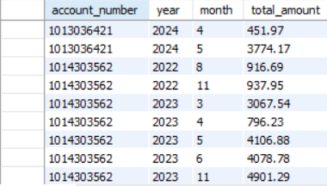
Q.2
SELECT account_number,year(transaction_date) as year ,month(transaction_date) as month,sum(amount) as total_amount
from transactions t
group by account_number,year(transaction_date),month(transaction_date)
order by account_number,year,month;
Summarize the total transaction amount per account per month.

Slide 8
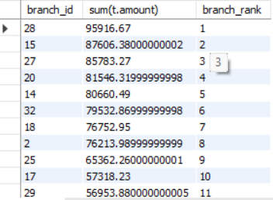
Q.3
SELECT a.branch_id,sum(t.amount) , dense_rank() over(order by sum(t.amount) desc) as branch_rank
from accounts a inner join transactions t using(account_number)
where t.transaction_type="Deposit" and
t.transaction_date>=date_sub(current_date(),interval 3 month) group by a.branch_id
order by branch_rank;
Rank branches based on the total amount of deposits made in the last quarter.

Slide 9
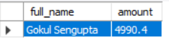
Q.4
SELECT concat(c.first_name," ",c.last_name) as full_name, t.amount
from customers c inner join accounts a on c.customer_id=a.customer_id inner join transactions t on t.account_number=a.account_number
where t.transaction_type="Deposit"
order by t.amount desc
limit 1;
Find the name of the customer who has deposited the highest amount.

Slide 10
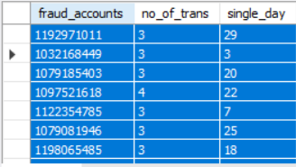
Q.5
SELECT a.account_number as fraud_accounts,count(t.transaction_id) as no_of_trans,day(t.transaction_date) as single_day
from accounts a inner join transactions t using(account_number)
group by fraud_accounts,single_day
having no_of_trans>2;
Identify any accounts that have made more than two transactions in a single day, which could indicate fraudulent activity.

Slide 11
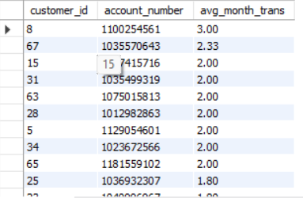
Q.6
WITH MonthlyTransactions AS (
SELECT
a.customer_id,
a.account_number,
YEAR(t.transaction_date) AS transaction_year,
MONTH(t.transaction_date) AS transaction_month,
COUNT(t.transaction_id) AS num_transactions
FROM
accounts a
INNER JOIN
transactions t ON a.account_number = t.account_number
WHERE
t.transaction_date >= DATE_SUB(CURRENT_DATE(), INTERVAL 1 YEAR)
GROUP BY
a.customer_id,
a.account_number,
YEAR(t.transaction_date),
MONTH(t.transaction_date)
)
SELECT
customer_id,
account_number,
ROUND(AVG(num_transactions), 2) AS avg_month_trans
FROM
MonthlyTransactions
GROUP BY
customer_id,
account_number
ORDER BY
avg_month_trans DESC;
Calculate the average number of transactions per customer per account per month over the last year.

Slide 12
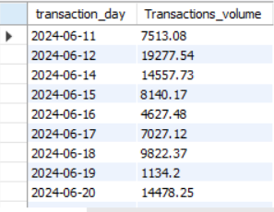
Q.7
SELECT date(transaction_date) as transaction_day,round(sum(amount),3) as Transactions_volume
from transactions
where transaction_date>=date_sub(current_date(),interval 1 month)
group by transaction_day
order by transaction_day;
Write a query to find the daily transaction volume (total amount of all transactions) for the past month.

Slide 13
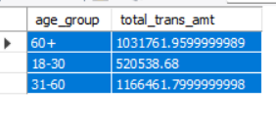
Q.8
SELECT case
When floor((datediff(current_date(),c.date_of_birth)/365)) between 0 and 17 then "0-17"
When floor((datediff(current_date(),c.date_of_birth)/365)) between 18 and 30 then "18-30"
When floor((datediff(current_date(),c.date_of_birth)/365)) between 31 and 60 then "31-60"
else "60+"
end as age_group,
sum(t.amount) as total_trans_amt
from customers c inner join accounts a on c.customer_id=a.customer_id inner join transactions t on t.account_number=a.account_number
where t.transaction_date>=date_sub(current_date(),interval 1 year)
group by age_group;
Calculate the total transaction amount performed by each age group in the past year. (Age groups: 0-17, 18-30, 31-60, 60+)

Slide 14
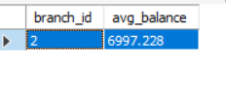
Q.9
SELECT branch_id,avg(balance) as avg_balance
from accounts
group by branch_id
order by avg_balance desc
limit 1;
Find the branch with the highest average account balance.

Slide 15
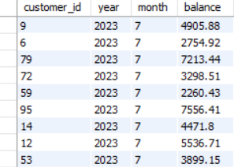
Q.10
SELECT a.customer_id,year(t.transaction_date) as year,month(t.transaction_date) as month ,round(avg(a.balance),2)as balance
from accounts a join transactions t using(account_number)
where t.transaction_date>=date_sub(current_date,interval 1 year)
group by customer_id,year,month
order by year,month;
Calculate the average balance per customer at the end of each month in last year.

Slide 16
4. Conclusion :
This project effectively leveraged SQL to extract, analyze, and interpret banking data, yielding actionable insights that can drive strategic decisions. The detailed analysis of customer behavior, transaction patterns, and branch performance equips the bank with the knowledge to enhance customer engagement, improve financial performance, and detect potential fraud. By continuing to utilize data analytics, the bank can foster a data-driven culture that supports growth and innovation.A one-line description of it

Slide 17

Thanks!
Regards-Piyush Kadam

